Slide 1






Social Marketplace for Fisheries
Social Marketplace for Fisheries
Social Marketplace for Fisheries
Group 4
Moumita Rahman Rimjhim 2011007042
Ihsanul Haque Asif 2013664042
Tamanna Rahman 2021450642
Md. Shakibur Rahman 2013534042

Slide 2
Description
A social marketplace for fisheries that connects buyers and sellers in one place over the internet. Through this marketplace, a business can process orders, accept payments, manage shipping and logistics, and provide customer service. Sellers from all over the country can register and connect with their buyers. There will be three user interfaces; buyers, sellers, and administrators.

Slide 3

Does the project have a clear target market or audience?
Our target audience is the fisheries warehouses/fish seller as the sellers and the people from different cities as our buyers.
In the market, buyers do not find every available fish/dry fish as their need or choice. At the same time, sellers do not find exact customers for their products. Location and connectivity are barriers for both of them. This project will be able to connect sellers and buyers from all over the country through the website.

Slide 4

Does the team demonstrate a thorough understanding of the need, problem or opportunity, including evidence of research into the need, problem or opportunity?
We are solving the problem of connecting sellers and buyers in one place.
In the market, we found that buyers need to find their desired product quickly, and sellers need more product sales. Buyers need fresh products also.
Opportunities for sellers are getting a good price for their products as there will be no middleman in the market, and connects seller directly. Buyers are getting desired products at less cost and can save their time.

Slide 5
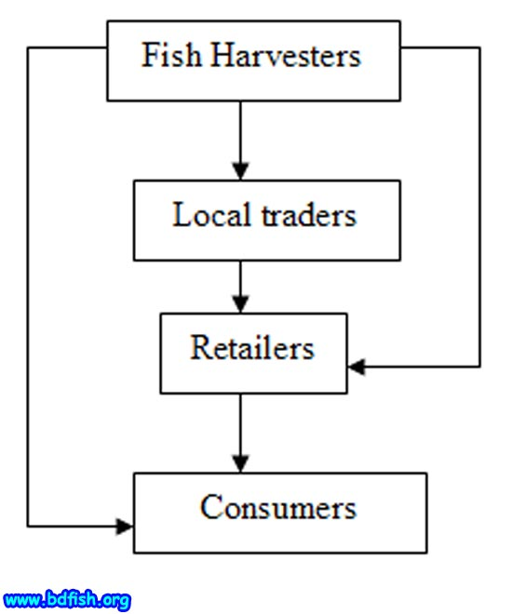
Is the project’s purpose and basic functionality easily understood?
Purpose:
Economical Development
Increased exposure
Good customer relationships
Online advertising
Reasonable price
Fresh Fish
Functionalities:
Easy Orders
User-Friendly UI
Product/Seller Information
Customer Reviews
Process billing system
Product Delivery Management
Products Additional Discounts

